Slide 1

Python Demo Nandani Patidar

Slide 2
Table of Content
Aggregate ranking based on seven criteria
User can input three criteria of his choice and aggregate ranking(of input) will be displayed.
Top five and bottom five countries name
Visualization tool
User can input 10 set of countries.
User can input data of his/her choice to see a plot.
Analysis of top countries (aggregate ranking)
A few random comparison and see whether any correlation exist.

Slide 3
First Part of Project- Rank Countries
There are total 195 countries and seven criteria of comparison
Life Expectancy (LE)
Population Density (PD)
Per Capita Income (PCI)
Human Development Index (HDI)
Democracy Score (DS)
Freedom Index (FI)
Government share of health spending in percentage (GHS)

Slide 4
Top five countries vs Bottom five countries based on HDI, DS and FI
Top Five Countries | Bottom Five Countries
1 Norway | 1 North Korea
2 Australia | 2 Eritrea
3 Switzerland | 3 Central African Republic
4 Germany | 4 Somalia
5 Denmark | 5 South Sudan

Slide 5
Top five countries vs Bottom five countries based on LE , PD and PCI
Top Five Countries | Bottom Five Countries
1 Iceland | 1 Holy See
2 Australia | 2 Liechtenstein
3 Norway | 3 Burundi
4 Canada | 4 Tuvalu
5 Sweden | 5 Haiti

Slide 6
Second part of project - Analyses
Top countries analysis for 10 years.

Slide 7
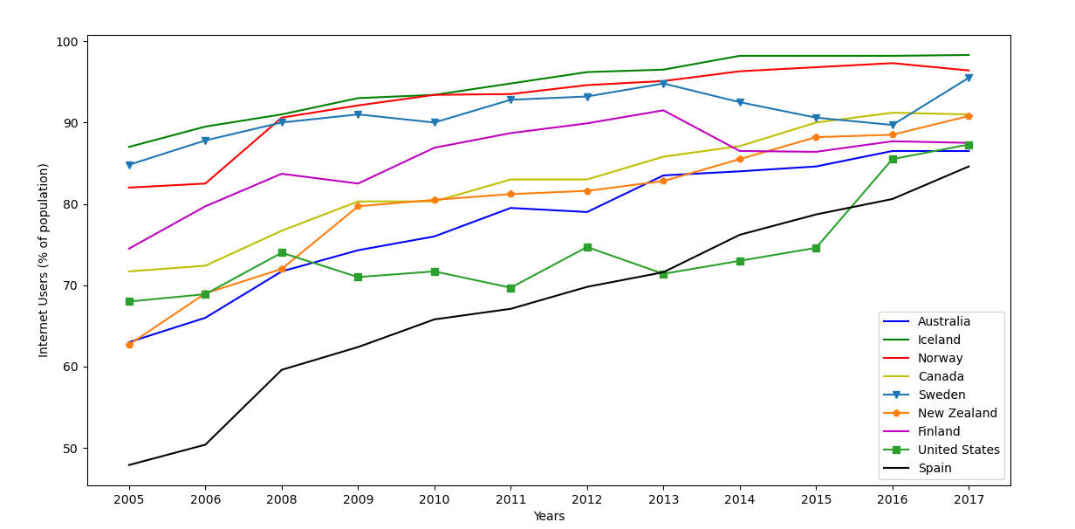
Spain had less than 50 percent users in 2005 which now has more than 80 percent internet users. In Iceland nearly 100 percent people use internet.

Slide 8
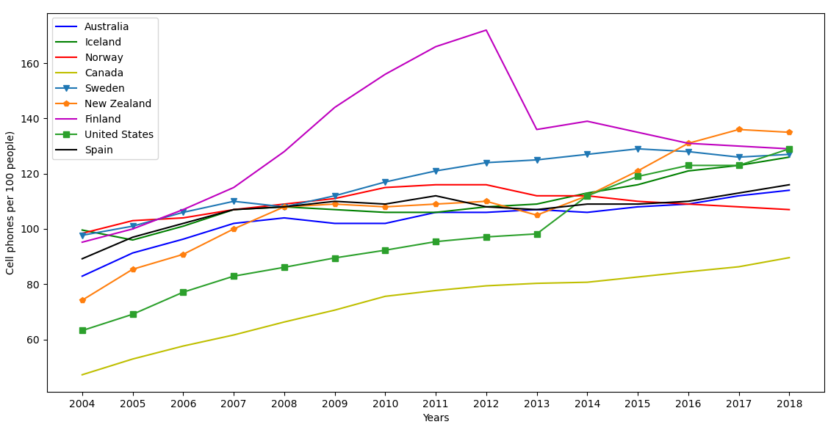
Finland had surprisingly more than 170 cell phones per 100 people in year 2012.

Slide 9
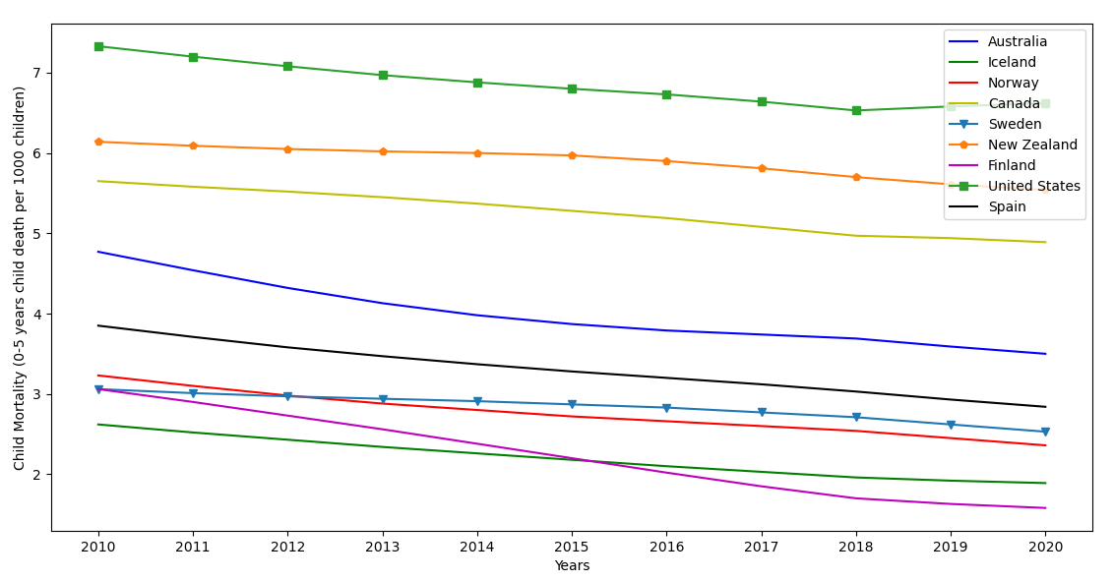
Finland has significantly improved comparing to other countries and it has least deaths per 1000 children

Slide 10
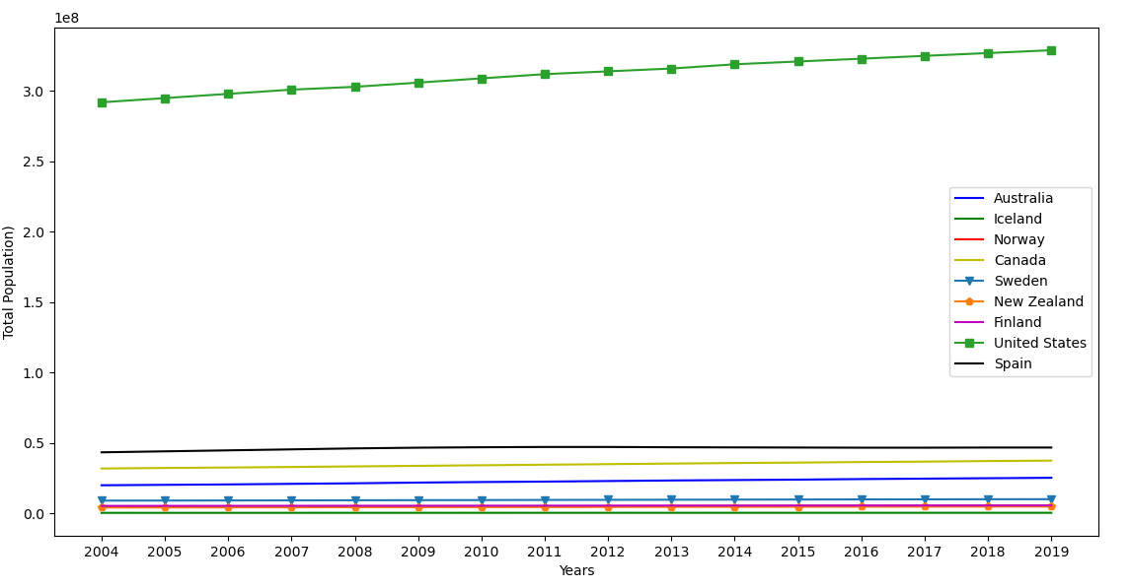
Population is shown in factor of 100 million.

Slide 11
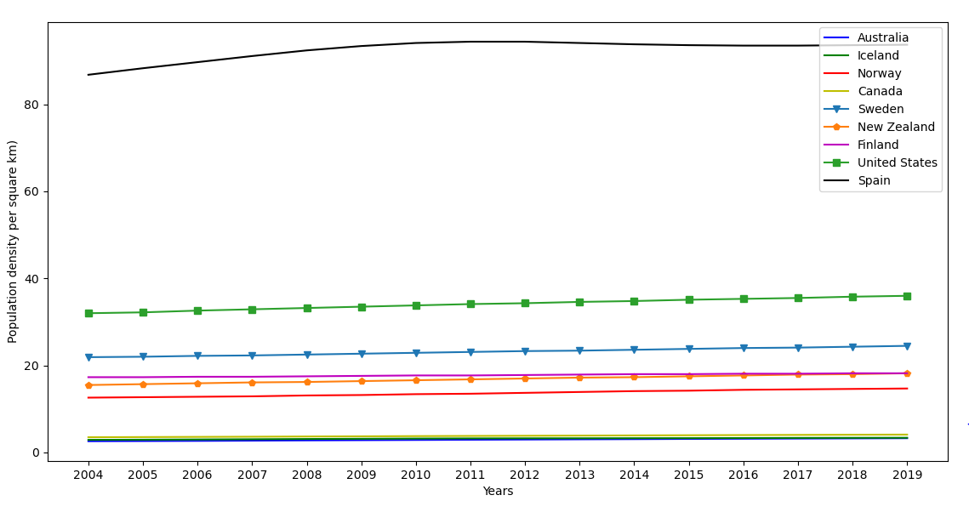
Norway is highly populated per square km as compare to other countries.

Slide 12
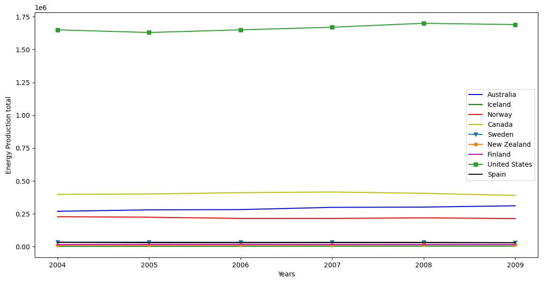

Slide 13
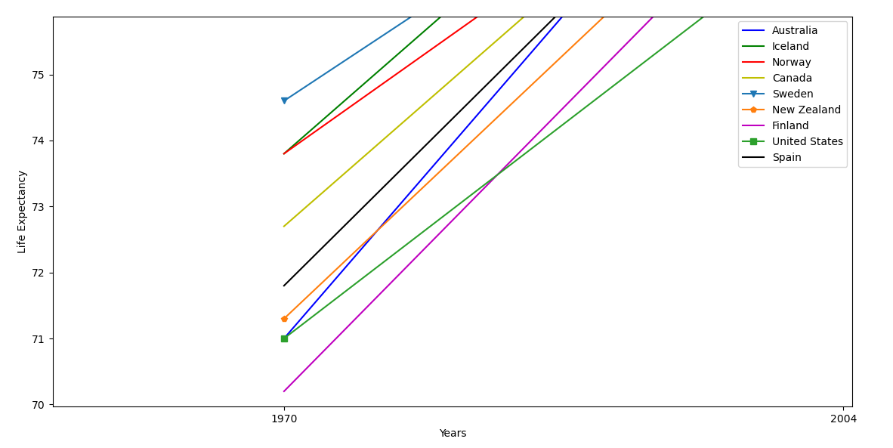
Australia and United States had exactly same life expectancy in 1970 similarly Norway and Iceland had same life expectancy.

Slide 14
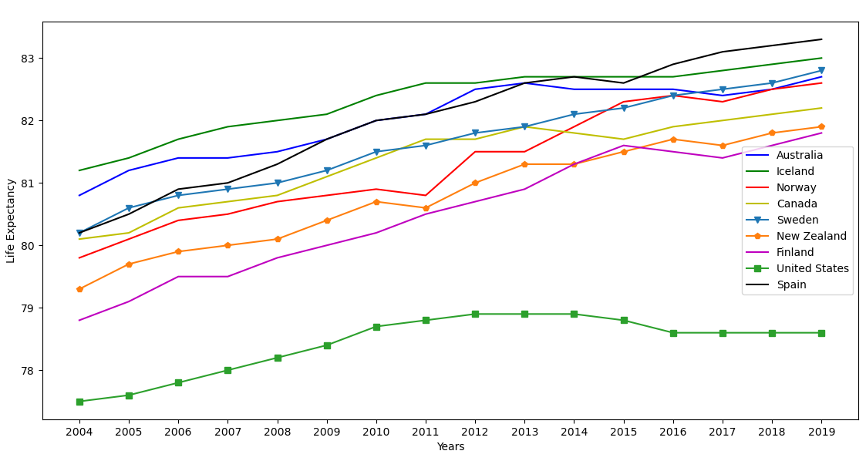
Norway and Iceland has nearly same life expectancy and Australia has significantly improved over years from 1970 as compared to United States. Spain has significantly improved over these years in terms of Life expectancy.

Slide 15
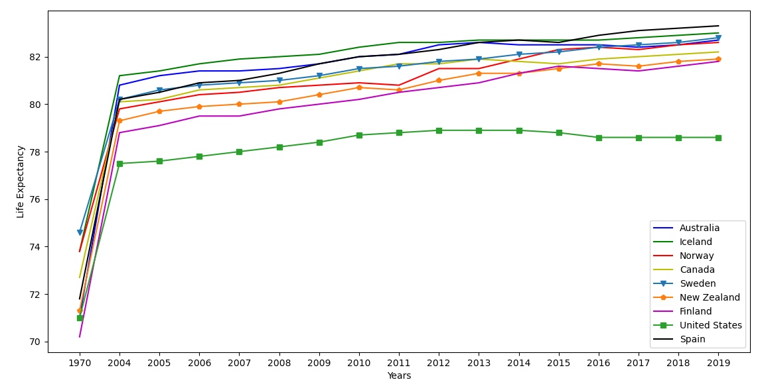

Slide 16
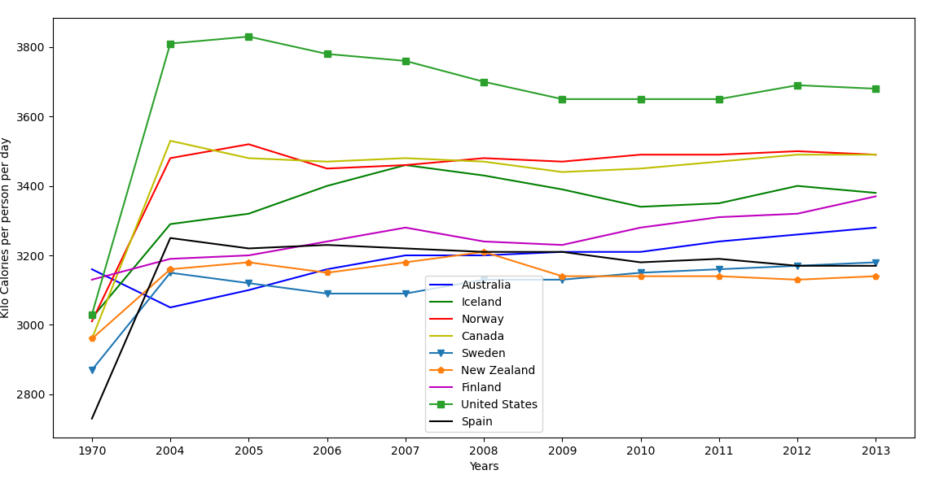
Food Supply : US food supplies was highest in 2004 , and it has decreased over followed years though it is highest in comparison with other countries.

Slide 17
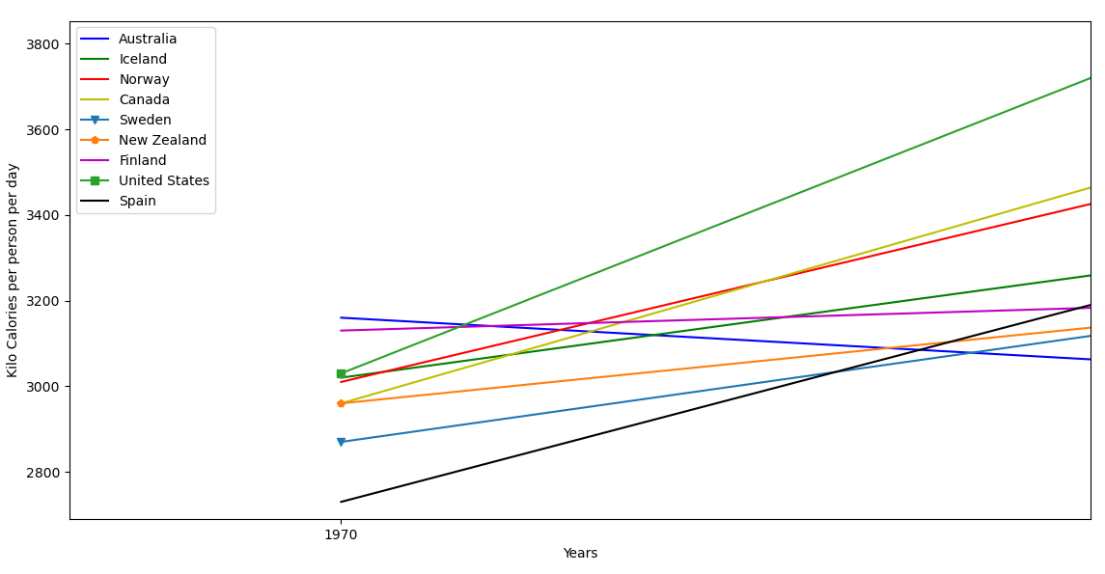
United States’s calories per person has drastically increased over years, in fact in 1970, it was similar with other countries shown below

Slide 18
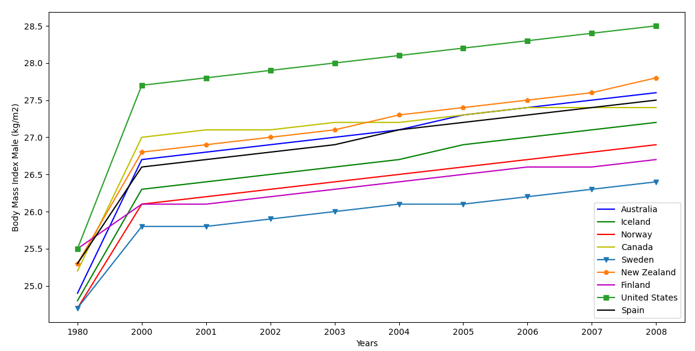

Slide 19
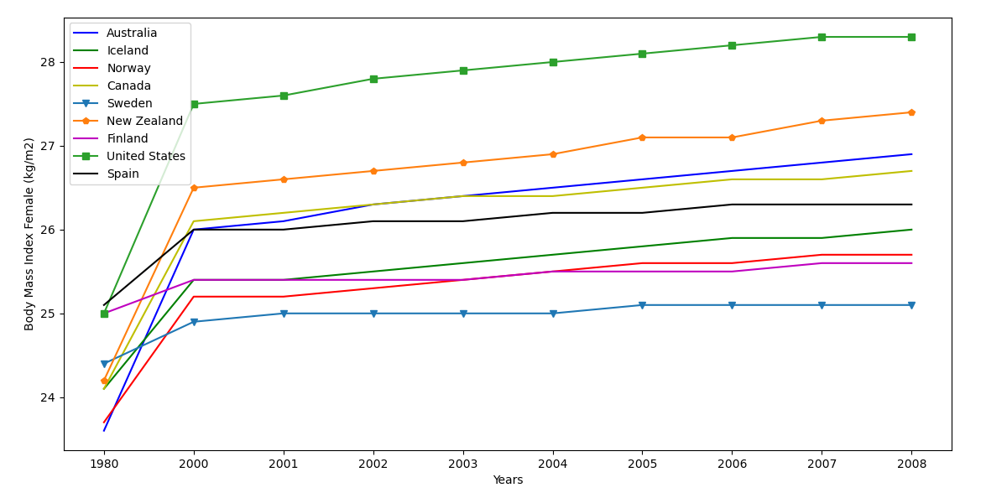
Risk factors : BMI United states female BMI’s is highest among these countries and it increased by factor more than three from year 1980 to 2008 which is highest comparing with other countries in the graph

Slide 20
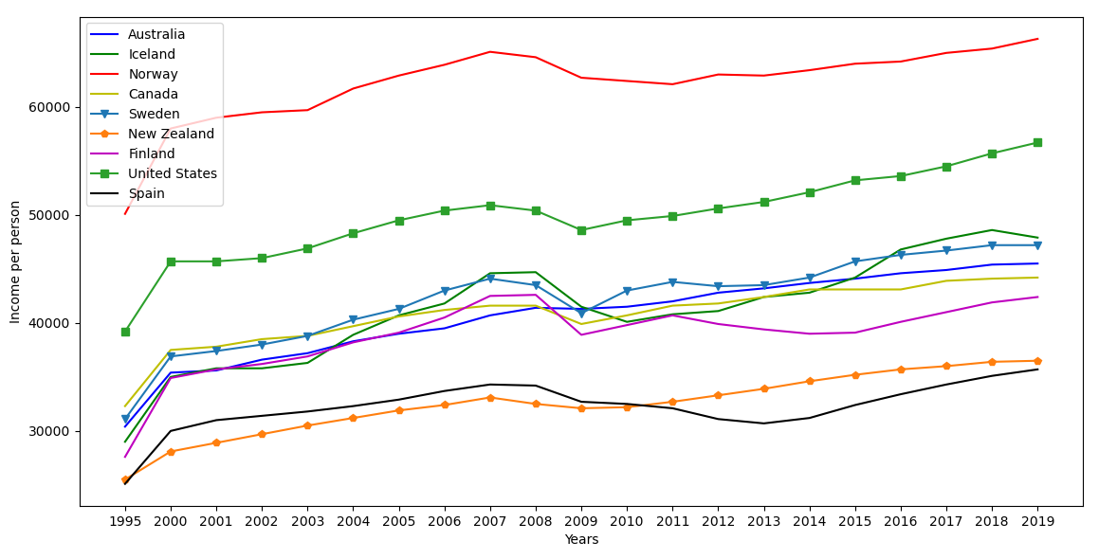
Norway has highest per capita income followed by United States.

Slide 21
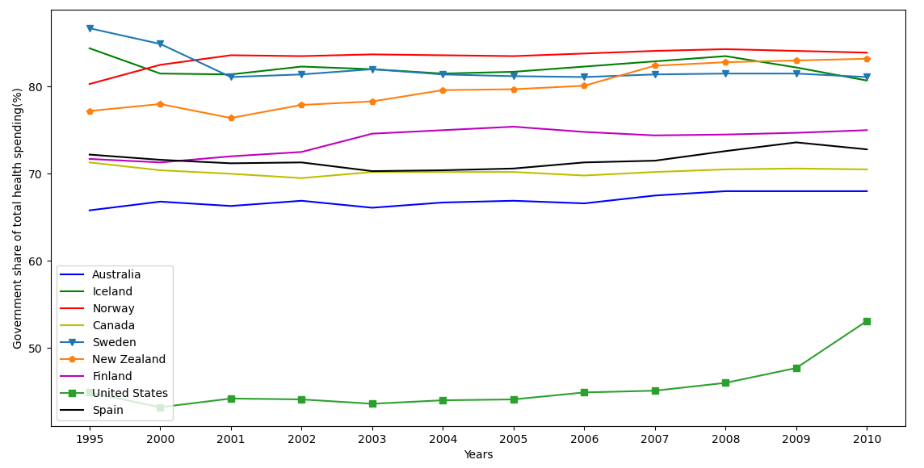
Norway’s government spends largest share in total health spending. Whereas United States government spends list despite second highest country based on Per Capita Income.

Slide 24
